Slide 1
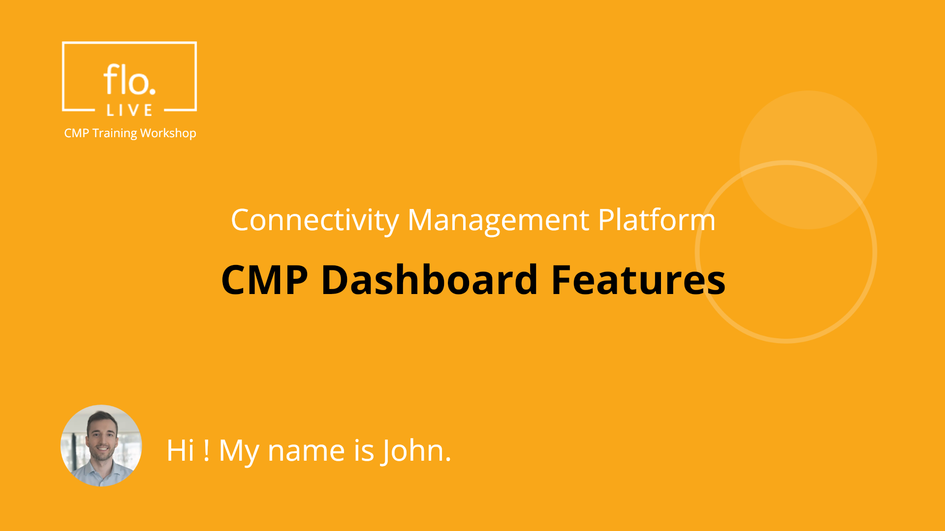
Notes:
Hi. My name is John and welcome to the CMP Training Workshop

Slide 2
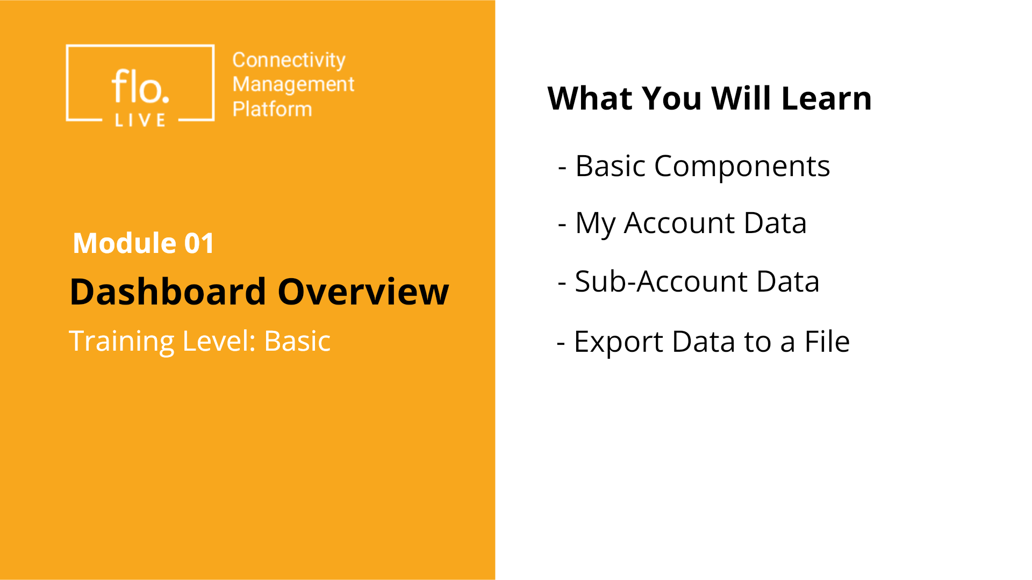
Notes:
In this video we explore the CMP dashboard.
We will start by introducing the main components and features of the Dashboard. Then, we'll look at My Account Data, where you’ll learn to access your personal metrics for better decision-making.
Next, we'll cover Sub Account Data, guiding you through managing and analyzing information across your sub-accounts. Finally, you’ll discover how to export data from the Dashboard's charts and graphs.

Slide 3
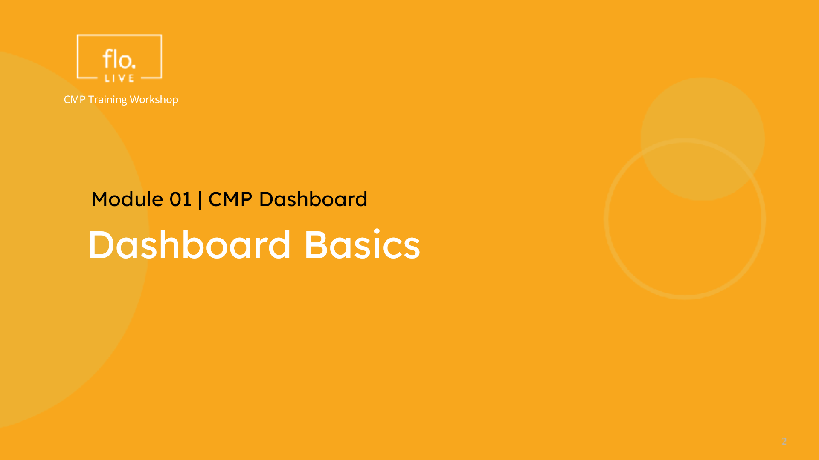
Notes:
Lets begin with an overview of the CMP dashboard components

Slide 4
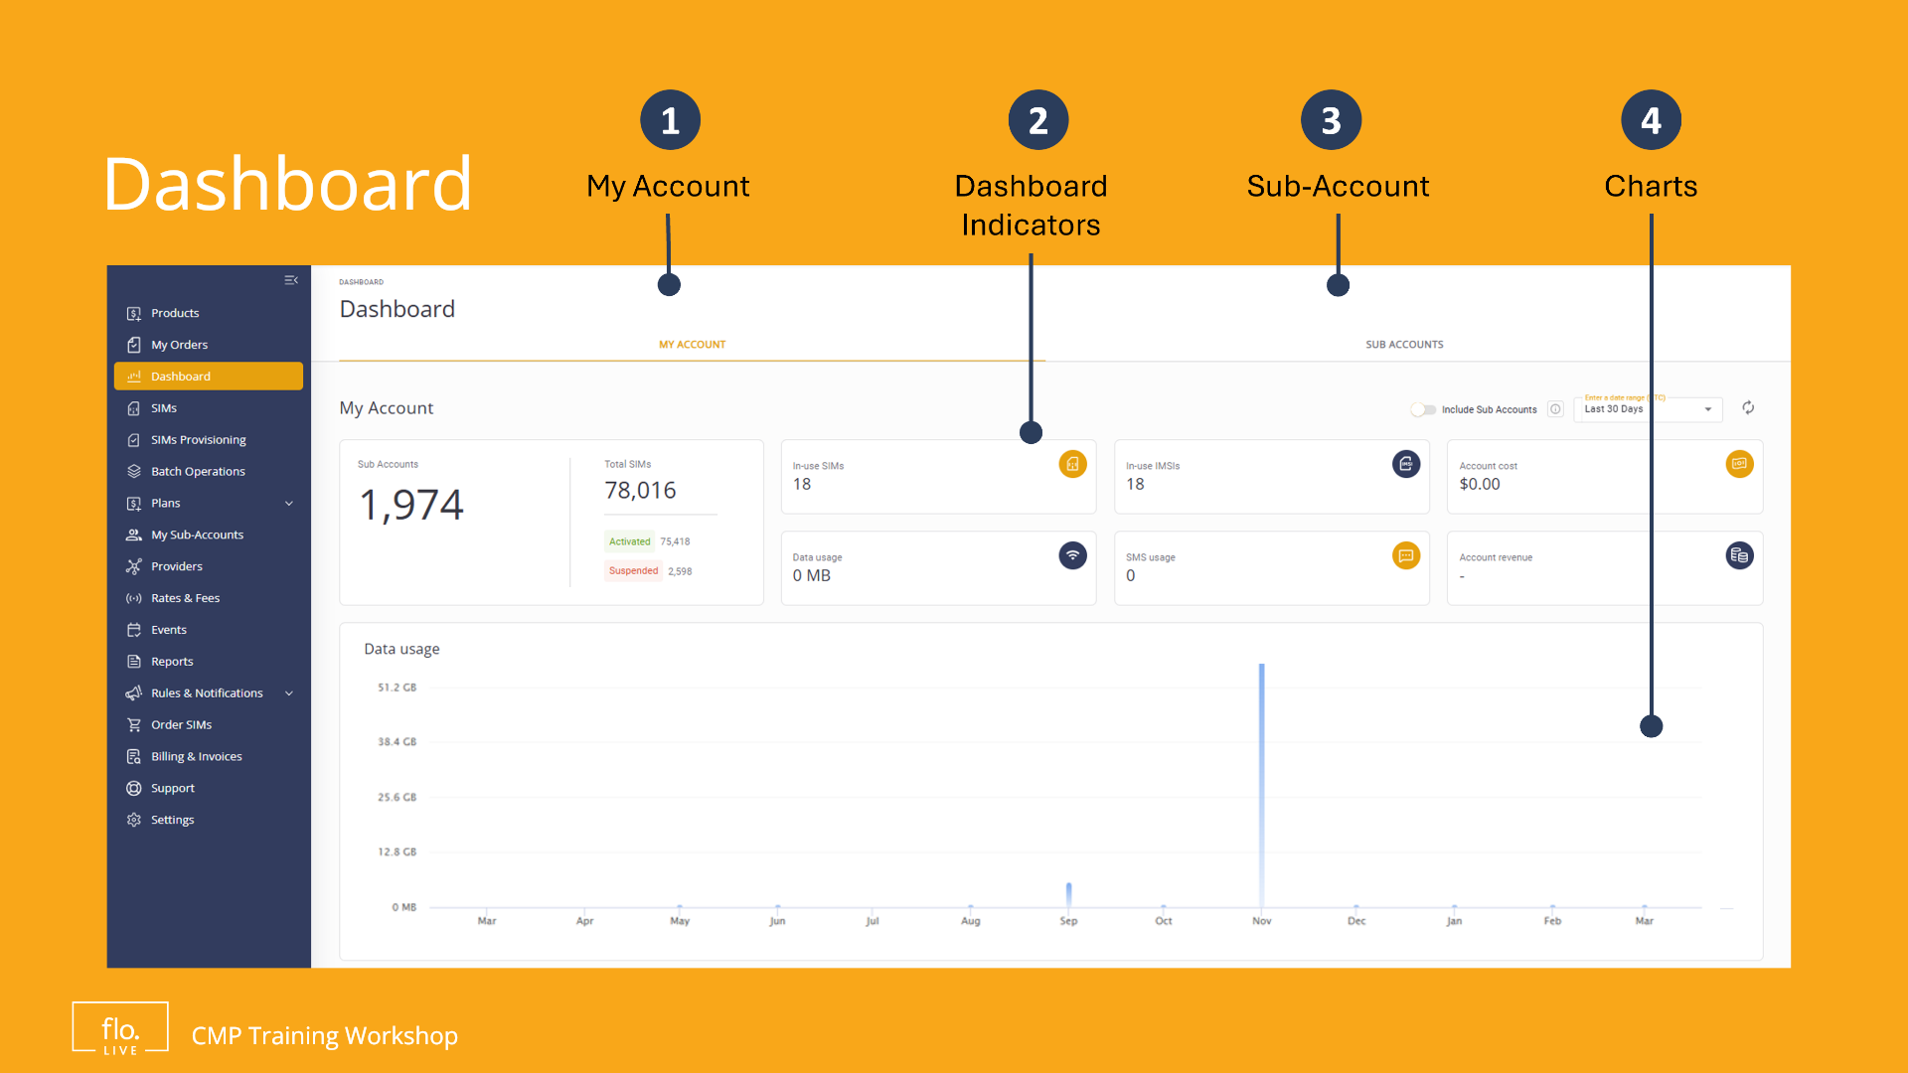
Notes:
The CMP dashboard is based on a simple and intuitive layout. It provides you with direct access to all your account information. Lets see how it works!

Slide 5
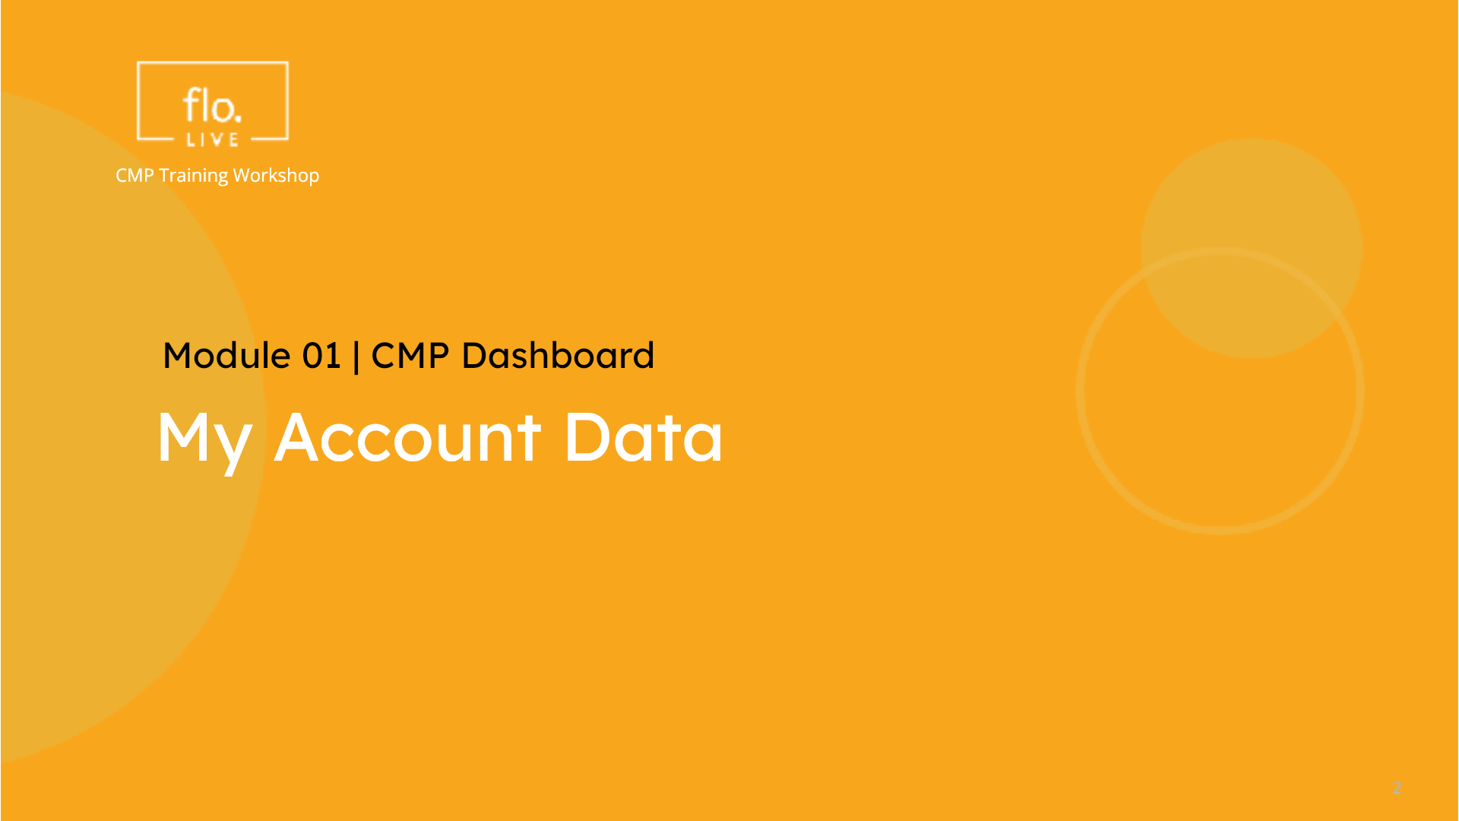
Notes:
We begin our tour of the Dashboard by viewing your account data.

Slide 6
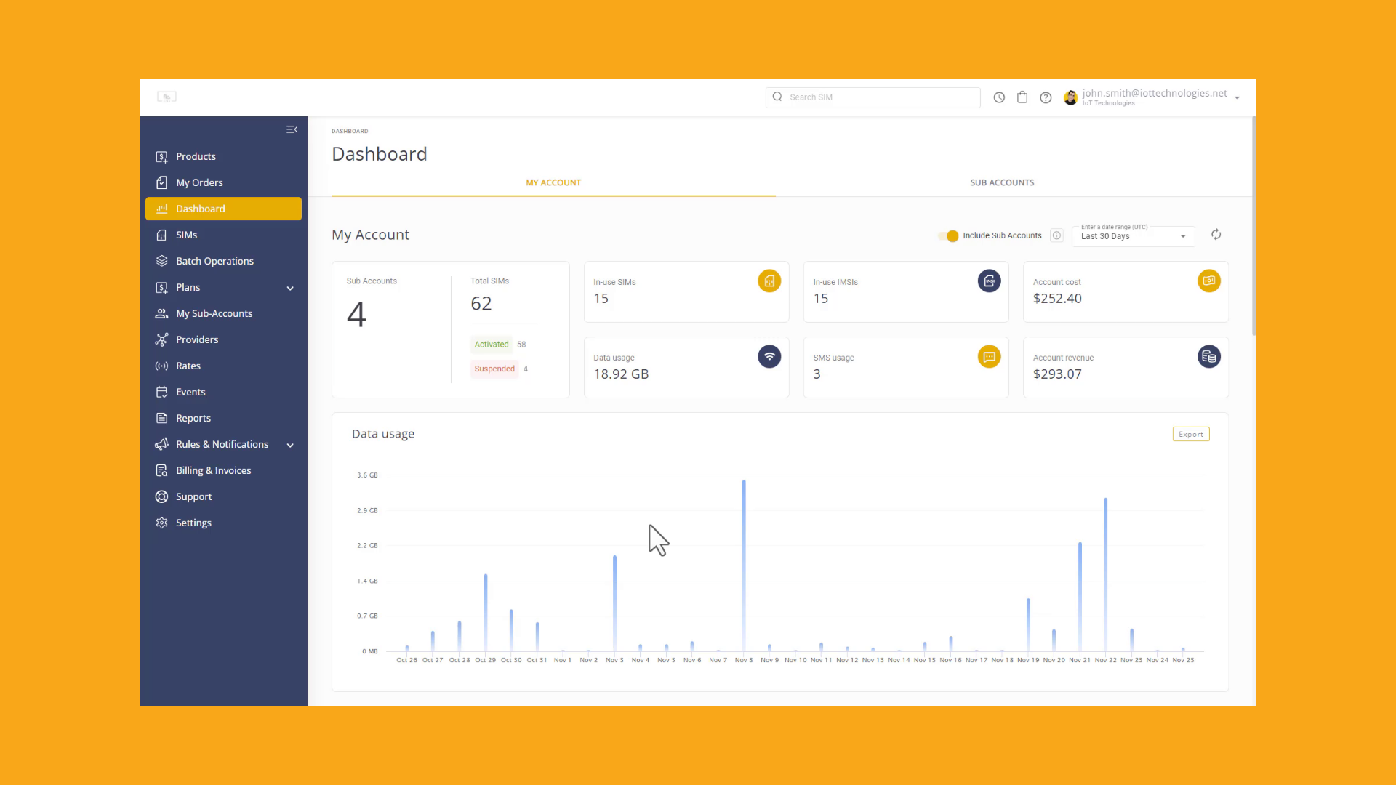
Notes:
The Dashboard appears automatically when you log into the CMP system. Notice that it has two tabs.
The My Account tab shows data from your Account, with the option to include or exclude your sub-accounts.
At the top of the page, you'll find key activity indicators that display data for your account and the sub-accounts managed under your Account.
The CMP Dashboard is fully scrollable, allowing you to explore various charts and graphs. These visualizations help you identify key trends in data and SMS usage, financial performance, and the global location of your SIMs. Lets go back to the top of the page. You can toggle the "Include Sub-Accounts" option to include or exclude data shown in the Parent Account tab. . Notice how the Dashboard data updates when you toggle this option. You can also filter the data by selecting a preset or custom timeframe. Again, the dashboard data automatically updates when you adjust these options.

Slide 7
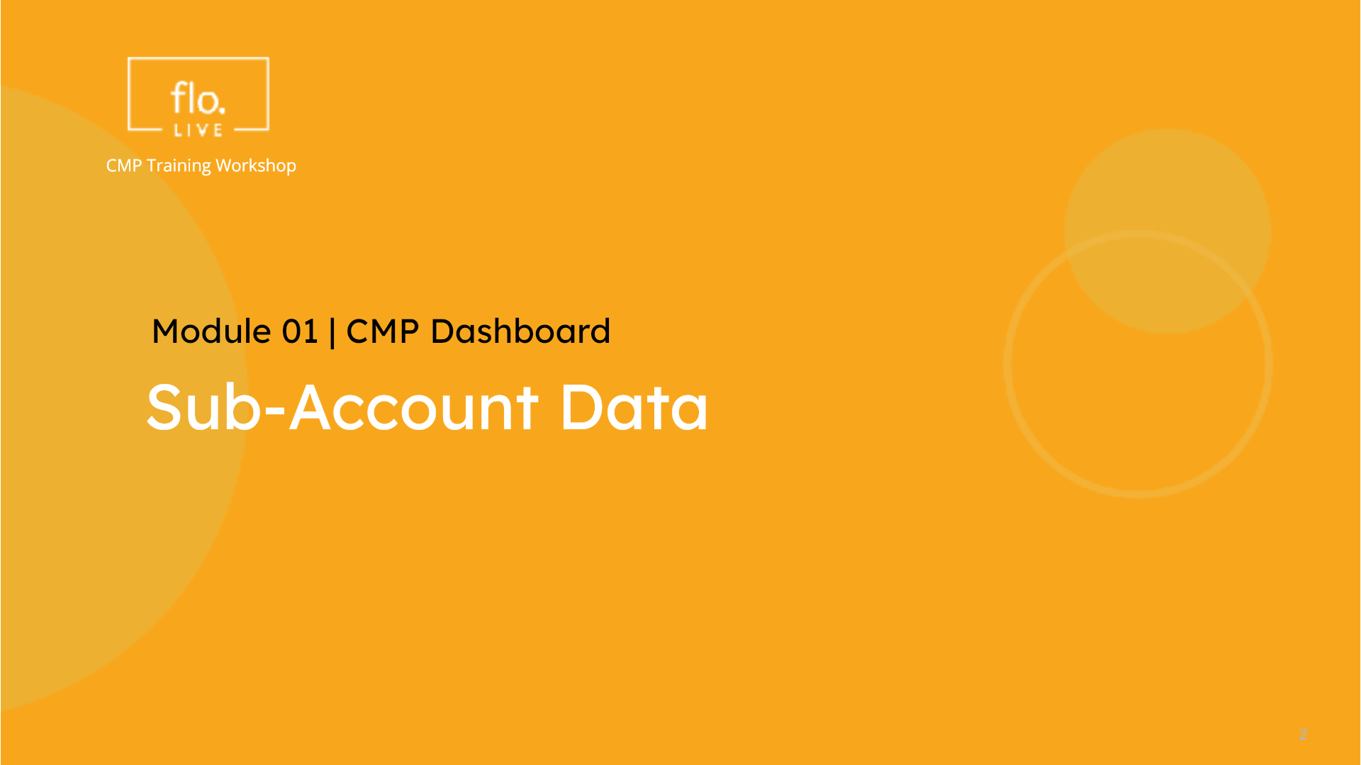
Notes:
Now that you know how to use the CMP Dashboard, lets take a look at the data displayed in the Sub Account tab.

Slide 8
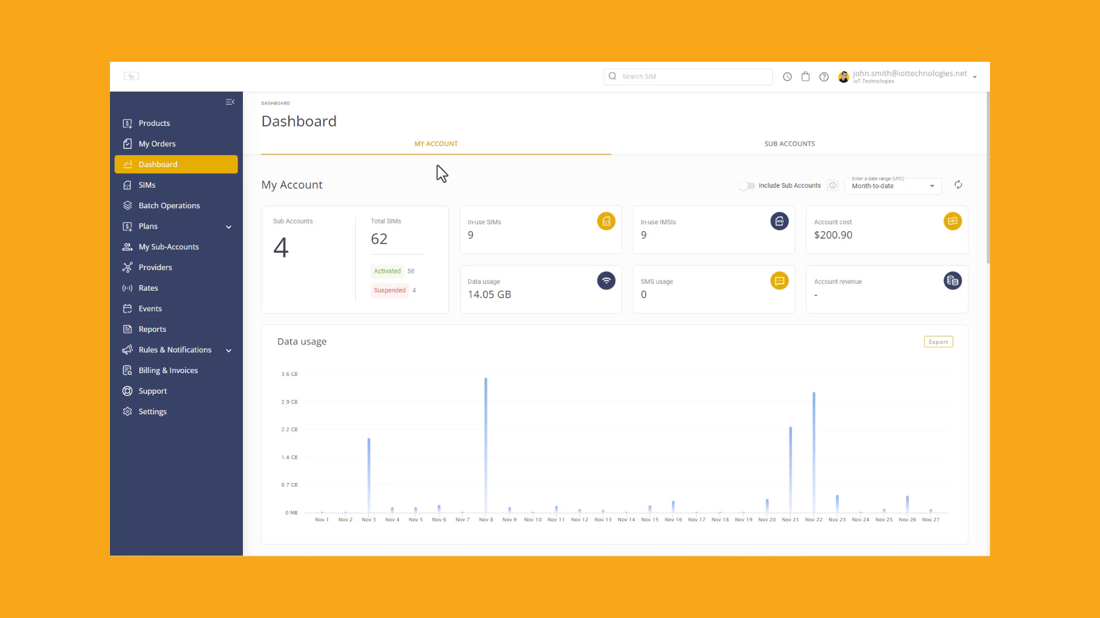
Notes:
Click the Sub-Account tab. This page is similar to the parent account. As you scroll down, check out the charts for your selected sub accounts. Notice that some of the charts may be empty. If a chart is empty, it just means there was no activity during that time frame. No worries, simply scroll to the top of the page to select one or more sub-accounts. When you select or deselect your sub-accounts the CMP system automatically updates the data and charts displayed on the page. Don't forget to set an appropriate timeframe. One final point you may find useful. The In-Use SIMs chart enables you display thenumber of IMSIs currently in use by the selected sub-account. This is very useful as it show you exactly how many IMSIs are actually in use by the selected sub-account for the specified time frame.

Slide 9
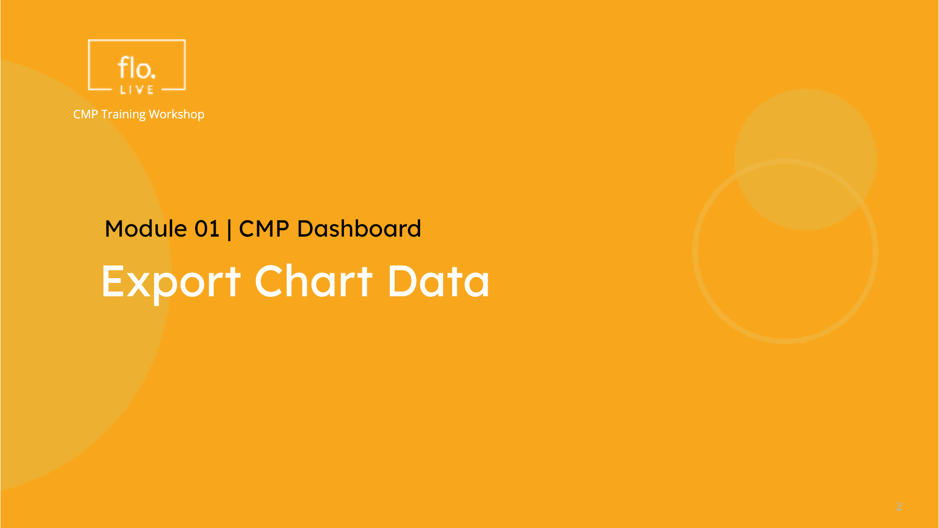
Notes:
Before we complete this tutorial, lets explore how to export the data from the My-Account and Sub-Account charts.

Slide 10
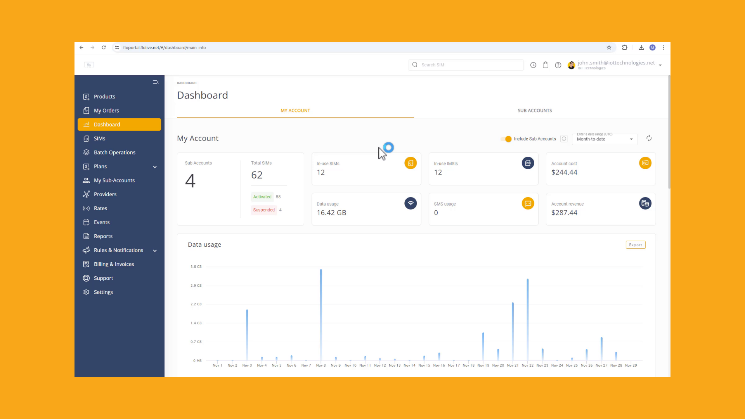
Notes:
Go to the CMP Dashboard and select the My Accounttab or alternatively click the Sub-Account tab. . Navigate to the chart that contains the data you want to export. Notice that each chart contains a button Labelled Export. Click the Export button to generate a csv file. The exported data is saved to the Download folder on your computer.

Slide 11
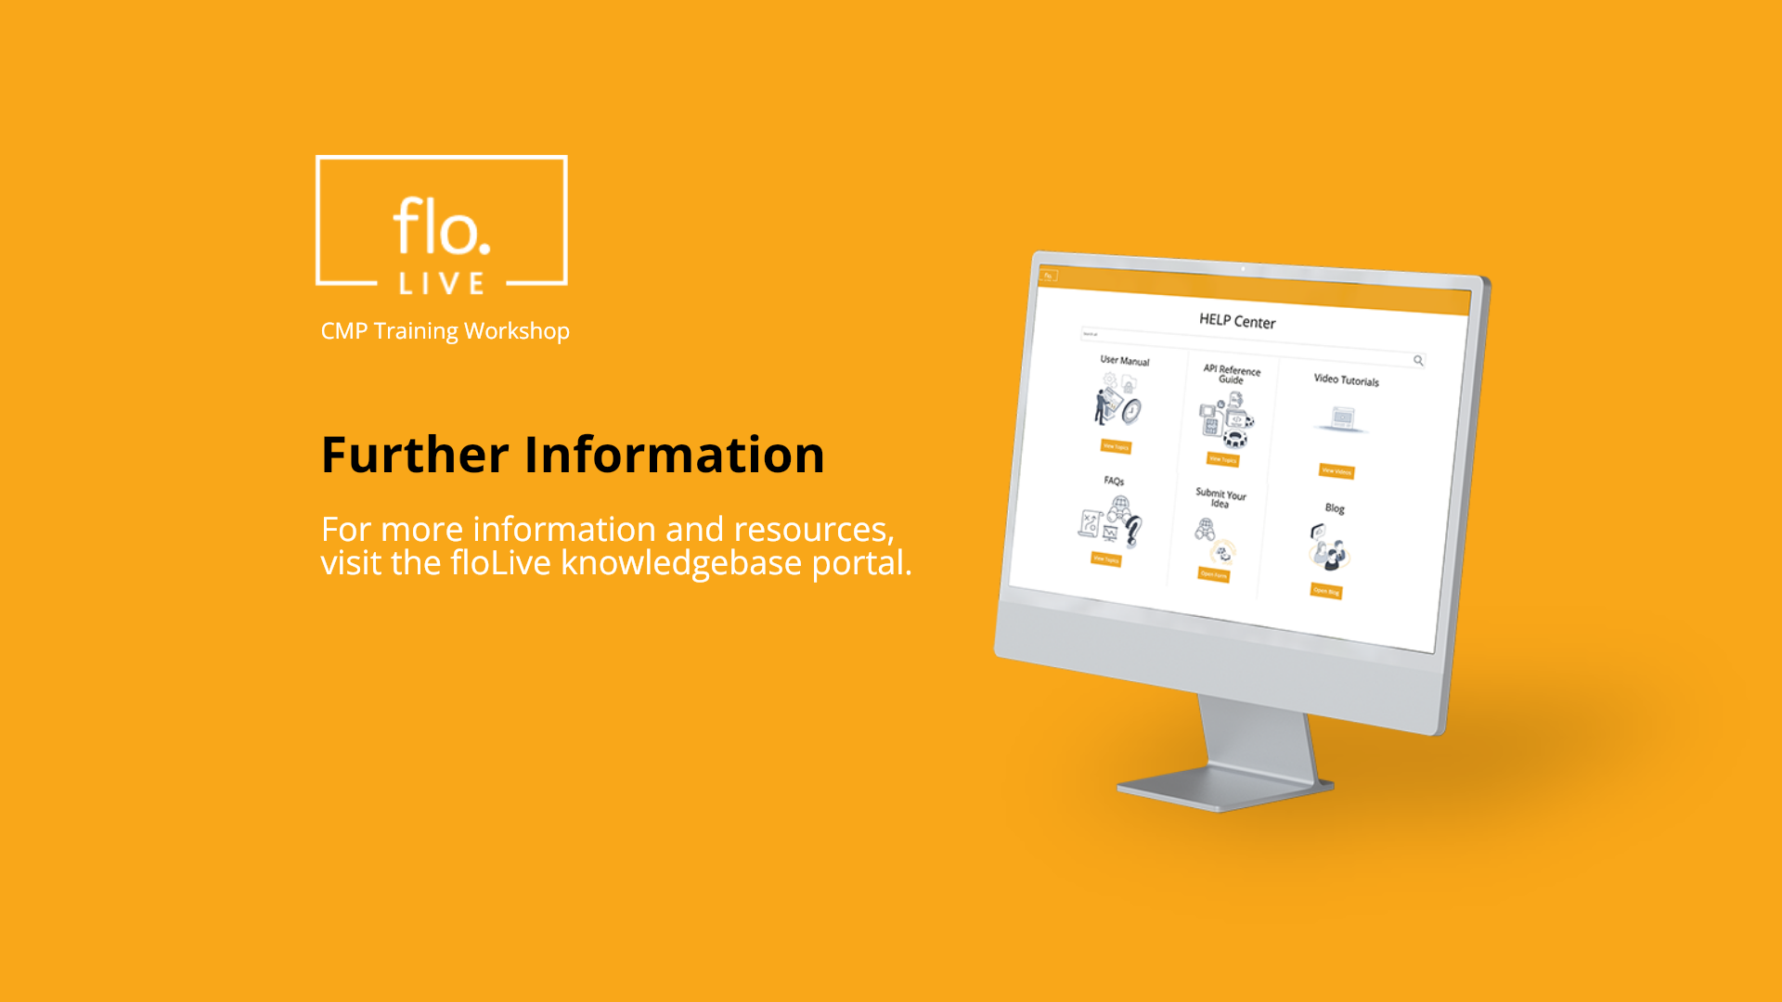
Notes:
Thank you for watching this video. For more information and resources, you can access our knowledge-base directly from the CMP portal.

